Slide 1
.NET of Things

Slide 2
What this talk is:
100 Level Overview
.NET

Slide 3
What this talk isn’t:
Electronics
Native C/C++
Anything Internet related

Slide 4
Word Cloud
C#
.NET Core
.NET Standard
UWP
Gadgeteer
.NET MicroFramework
TinyCLR OS
Meadow

Slide 5
Raspberry Pi
ARM CPU
“Low Resources”
1.4 GHz 64 bit CPU
1 GB RAM
Pi 3 B+
Exposed Pins
The Money Maker

Slide 6
.NET MicroFramework
Legacy
Designed for MCUs
RAM ~300KB
CPU like Cortex-M3 @ 120 MHz
Limited in features
No generics
Limited MCU selection
Open Source
http://netmf.github.io/
Netduino 2 courtesy of https://www.wildernesslabs.co/

Slide 7
Cons
Limited Language Feature Support
No Generics
Required VS Extension to begin
Only worked on Community Version of VS
Maxed out at VS 2015

Slide 8
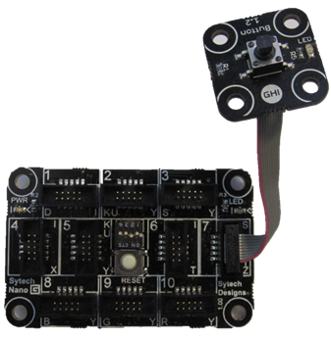
Gadgeteer
Extension of .NET MicroFramework
Easy Prototyping Platform
Expensive
Open Source
https://archive.codeplex.com/?p=gadgeteer
GHIElectronics FEZ Hydra
with Button module

Slide 12
TinyCLR OS
Created by GHI Electronics
https://www.ghielectronics.com/tinyclr/features
Can be ported to custom hardware
Modules hosted on NuGet
Not open source
Though documentation is
Supports native C/C++ code
No Generics Support

Slide 13
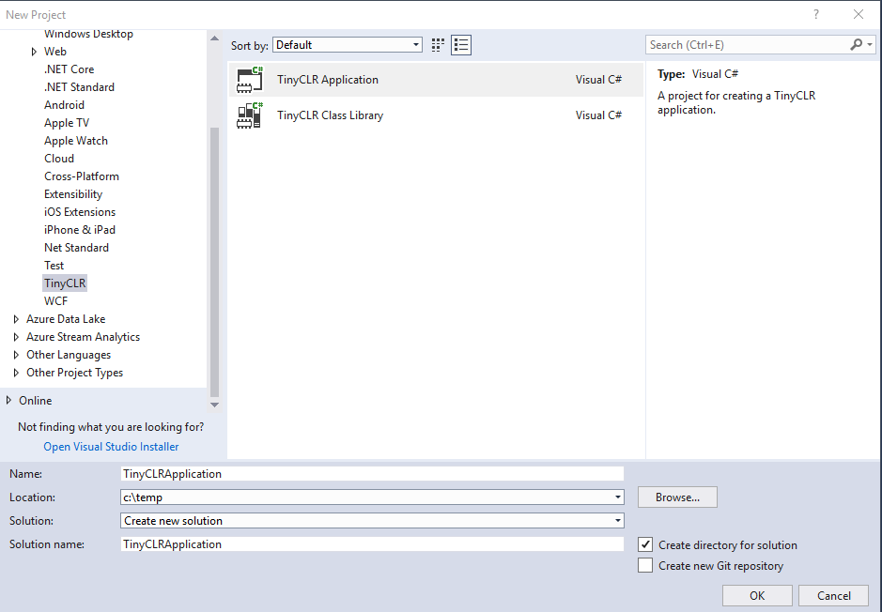
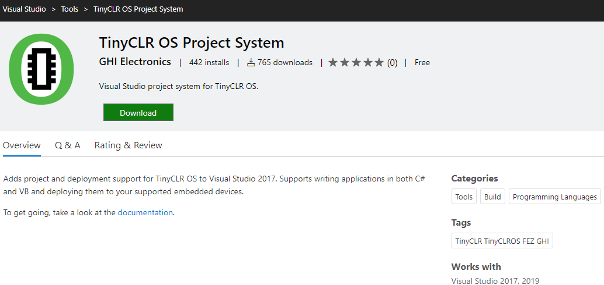
TinyCLR OS – Getting Setup
Follow simple instructions online
https://docs.ghielectronics.com/software/tinyclr/getting-started.html
Install “TinyCLR OS Project System” Extension to VS
https://marketplace.visualstudio.com/items?itemName=ghielectronics.tinyclr-projectsystem
Create new project

Slide 14
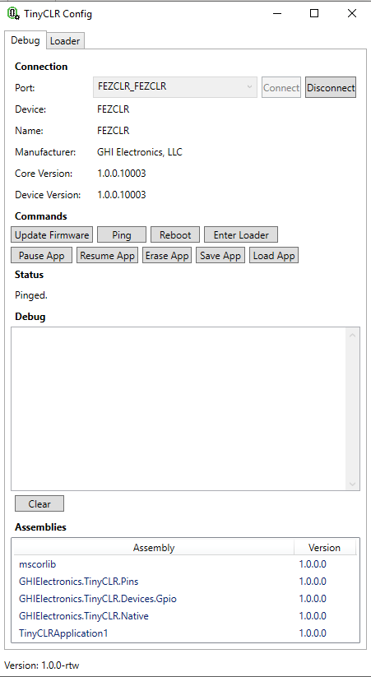
TinyCLR Config
Application to update device Firmware
Debug board
Might need this on first use of new board

Slide 15
Pros
Cons
NuGet Packages
No Generics Support
Can’t reference .NET Standard Libraries

